Slide 1
SEQUENTIAL CIRCUIT DESIGN
3 BIT Up/Down COUNTER JK Flip Flop
LECTURE 9

Slide 2
STEPS FOR SEQUENTIAL CIRCUIT DESIGN
State Diagram
Next State Table
State Reduction And Assignment
Flip Flop Transition Table (FLIP FLOP Selection)
Simplification
Input/output Equations
Implementations of Equation(Logic Diagram)

Slide 3
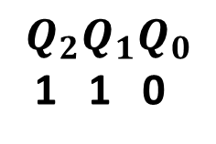
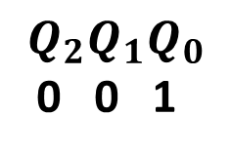
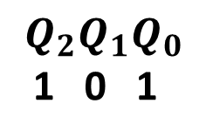
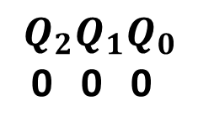
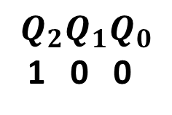
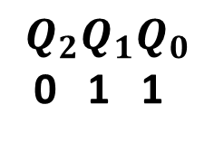
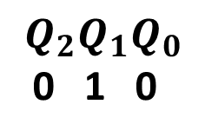
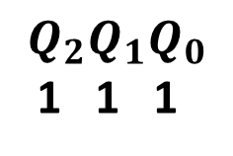
STATE DIAGRAM
X=1
$$Q_{2}Q_{1}Q_{0}$$
0 0 0
X=1
$$Q_{2}Q_{1}Q_{0}$$
1 1 1
$$Q_{2}Q_{1}Q_{0}$$
0 0 1
X=0
X=0
X=1
X=1
X=0
X=0
$$Q_{2}Q_{1}Q_{0}$$
1 1 0
$$Q_{2}Q_{1}Q_{0}$$
0 1 0
X=0
X=0
X=1
X=1
$$Q_{2}Q_{1}Q_{0}$$
1 0 1
$$Q_{2}Q_{1}Q_{0}$$
0 1 1
X=0
X=0
$$Q_{2}Q_{1}Q_{0}$$
1 0 0
X=1
X=1

Slide 4
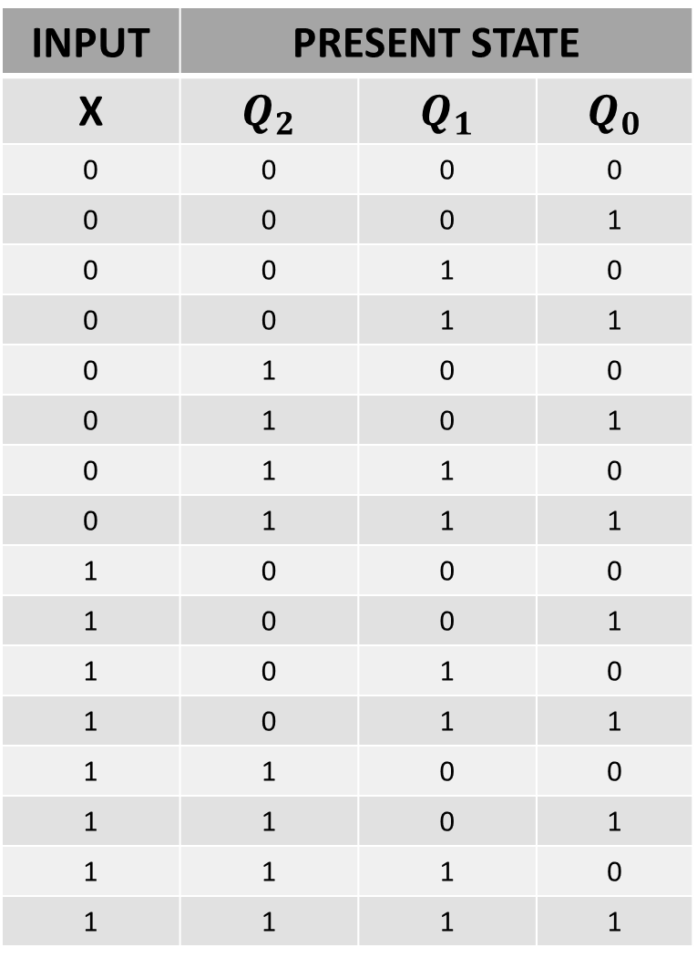
STATE TABLE
INPUT | PRESENT STATE
X | $$Q_{2}$$ | $$Q_{1}$$ | $$Q_{0}$$
0 | 0 | 0 | 0
0 | 0 | 0 | 1
0 | 0 | 1 | 0
0 | 0 | 1 | 1
0 | 1 | 0 | 0
0 | 1 | 0 | 1
0 | 1 | 1 | 0
0 | 1 | 1 | 1
1 | 0 | 0 | 0
1 | 0 | 0 | 1
1 | 0 | 1 | 0
1 | 0 | 1 | 1
1 | 1 | 0 | 0
1 | 1 | 0 | 1
1 | 1 | 1 | 0
1 | 1 | 1 | 1

Slide 5
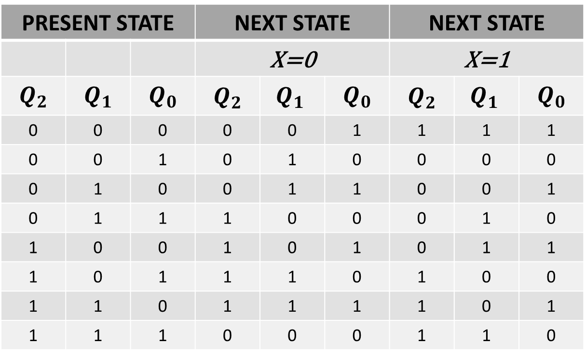
NEXT STATE TABLE
PRESENT STATE |  |  | NEXT STATE |  |  | NEXT STATE
 |  |  | X=0 |  |  | X=1
$$Q_{2}$$ | $$Q_{1}$$ | $$Q_{0}$$ | $$Q_{2}$$ | $${Q_{1}}_{ }$$ | $$Q_{0}$$ | $$Q_{2}$$ | $${Q_{1}}_{ }$$ | $$Q_{0}$$
0 | 0 | 0 | 0 | 0 | 1 | 1 | 1 | 1
0 | 0 | 1 | 0 | 1 | 0 | 0 | 0 | 0
0 | 1 | 0 | 0 | 1 | 1 | 0 | 0 | 1
0 | 1 | 1 | 1 | 0 | 0 | 0 | 1 | 0
1 | 0 | 0 | 1 | 0 | 1 | 0 | 1 | 1
1 | 0 | 1 | 1 | 1 | 0 | 1 | 0 | 0
1 | 1 | 0 | 1 | 1 | 1 | 1 | 0 | 1
1 | 1 | 1 | 0 | 0 | 0 | 1 | 1 | 0

Slide 6
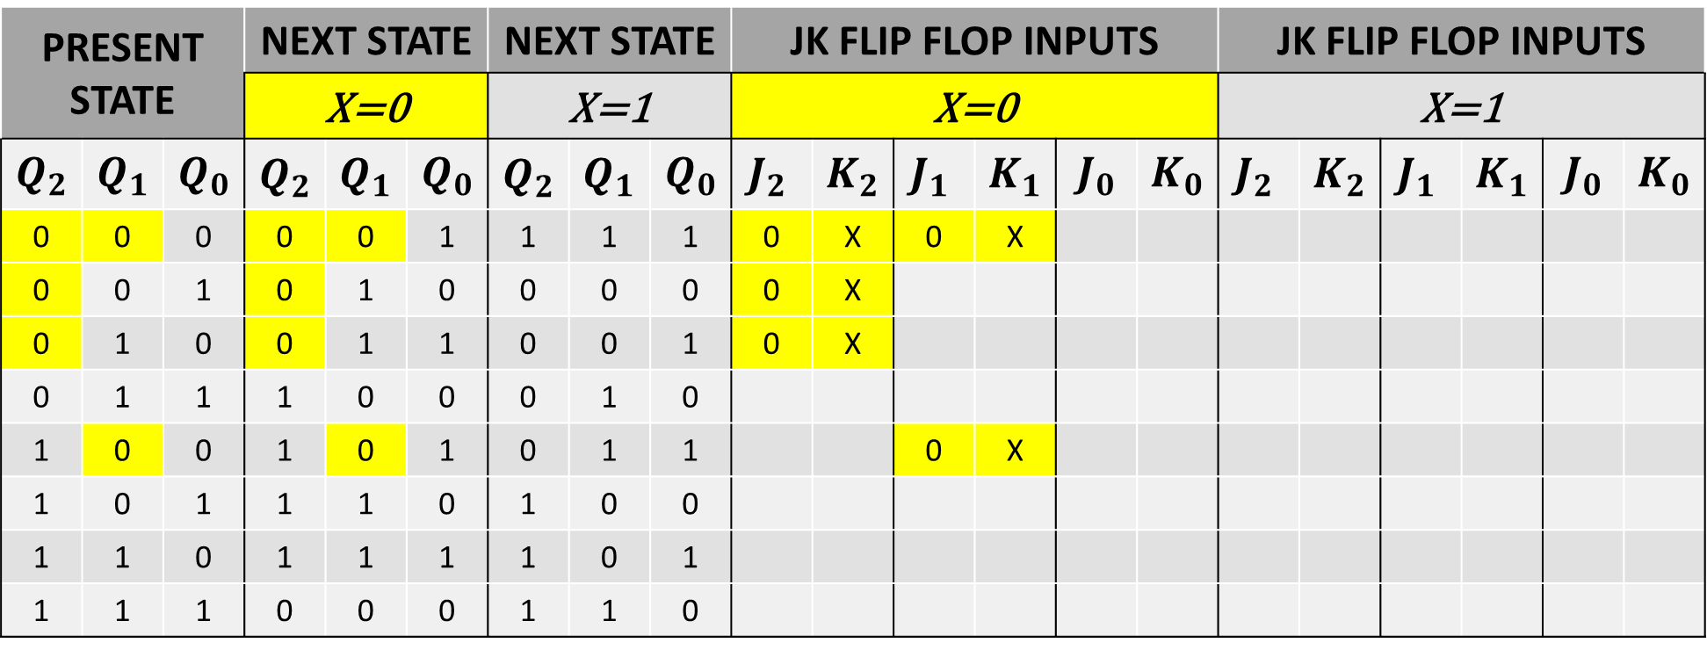
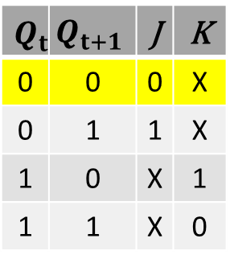
NEXT STATE TABLE USING JK FLIP FLOP for X=0
$$Q_{t}$$ | $$Q_{t+1}$$ | J | K
0 | 0 | 0 | X
0 | 1 | 1 | X
1 | 0 | X | 1
1 | 1 | X | 0
PRESENT STATE |  |  | NEXT STATE |  |  | NEXT STATE |  |  | JK FLIP FLOP INPUTS |  |  |  |  |  | JK FLIP FLOP INPUTS
 |  |  | X=0 |  |  | X=1 |  |  | X=0 |  |  |  |  |  | X=1
$$Q_{2}$$ | $$Q_{1}$$ | $$Q_{0}$$ | $$Q_{2}$$ | $${Q_{1}}_{ }$$ | $$Q_{0}$$ | $$Q_{2}$$ | $${Q_{1}}_{ }$$ | $$Q_{0}$$ | $${J_{2}}_{ }$$ | $${K_{2}}_{ }$$ | $${J_{1}}_{ }$$ | $${K_{1}}_{ }$$ | $$J_{0}$$ | $$K_{0}$$ | $${J_{2}}_{ }$$ | $${K_{2}}_{ }$$ | $${J_{1}}_{ }$$ | $${K_{1}}_{ }$$ | $$J_{0}$$ | $$K_{0}$$
0 | 0 | 0 | 0 | 0 | 1 | 1 | 1 | 1 | 0 | X | 0 | X
0 | 0 | 1 | 0 | 1 | 0 | 0 | 0 | 0 | 0 | X
0 | 1 | 0 | 0 | 1 | 1 | 0 | 0 | 1 | 0 | X
0 | 1 | 1 | 1 | 0 | 0 | 0 | 1 | 0
1 | 0 | 0 | 1 | 0 | 1 | 0 | 1 | 1 |  |  | 0 | X
1 | 0 | 1 | 1 | 1 | 0 | 1 | 0 | 0
1 | 1 | 0 | 1 | 1 | 1 | 1 | 0 | 1
1 | 1 | 1 | 0 | 0 | 0 | 1 | 1 | 0

Slide 7
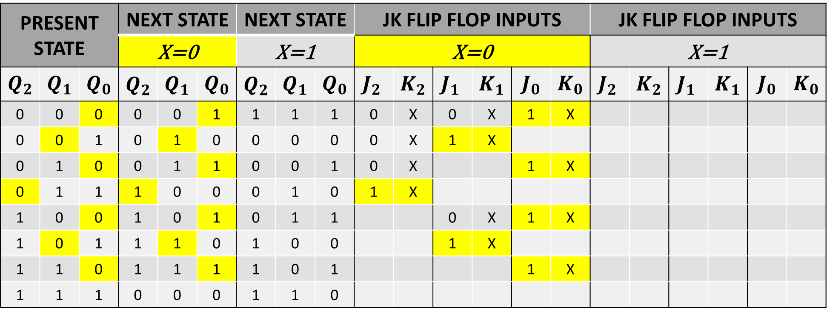
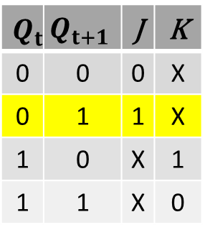
NEXT STATE TABLE USING JK FLIP FLOP for X=0
$$Q_{t}$$ | $$Q_{t+1}$$ | J | K
0 | 0 | 0 | X
0 | 1 | 1 | X
1 | 0 | X | 1
1 | 1 | X | 0
PRESENT STATE |  |  | NEXT STATE |  |  | NEXT STATE |  |  | JK FLIP FLOP INPUTS |  |  |  |  |  | JK FLIP FLOP INPUTS
 |  |  | X=0 |  |  | X=1 |  |  | X=0 |  |  |  |  |  | X=1
$$Q_{2}$$ | $$Q_{1}$$ | $$Q_{0}$$ | $$Q_{2}$$ | $${Q_{1}}_{ }$$ | $$Q_{0}$$ | $$Q_{2}$$ | $${Q_{1}}_{ }$$ | $$Q_{0}$$ | $${J_{2}}_{ }$$ | $${K_{2}}_{ }$$ | $${J_{1}}_{ }$$ | $${K_{1}}_{ }$$ | $$J_{0}$$ | $$K_{0}$$ | $${J_{2}}_{ }$$ | $${K_{2}}_{ }$$ | $${J_{1}}_{ }$$ | $${K_{1}}_{ }$$ | $$J_{0}$$ | $$K_{0}$$
0 | 0 | 0 | 0 | 0 | 1 | 1 | 1 | 1 | 0 | X | 0 | X | 1 | X
0 | 0 | 1 | 0 | 1 | 0 | 0 | 0 | 0 | 0 | X | 1 | X
0 | 1 | 0 | 0 | 1 | 1 | 0 | 0 | 1 | 0 | X |  |  | 1 | X
0 | 1 | 1 | 1 | 0 | 0 | 0 | 1 | 0 | 1 | X
1 | 0 | 0 | 1 | 0 | 1 | 0 | 1 | 1 |  |  | 0 | X | 1 | X
1 | 0 | 1 | 1 | 1 | 0 | 1 | 0 | 0 |  |  | 1 | X
1 | 1 | 0 | 1 | 1 | 1 | 1 | 0 | 1 |  |  |  |  | 1 | X
1 | 1 | 1 | 0 | 0 | 0 | 1 | 1 | 0

Slide 8
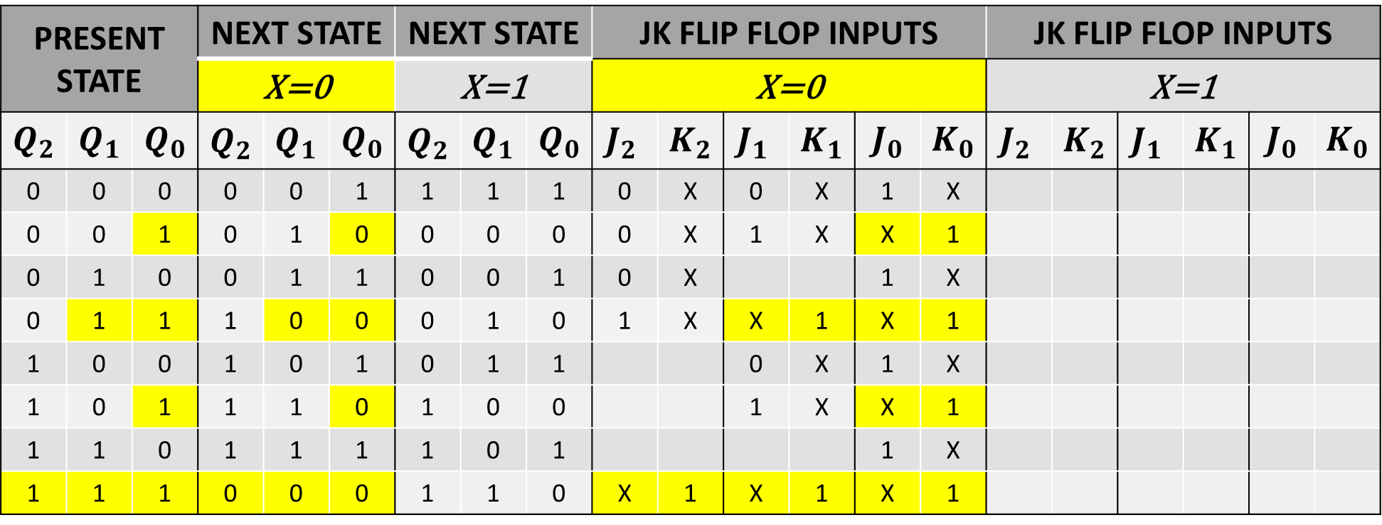
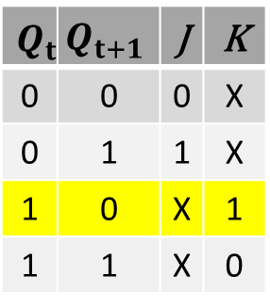
NEXT STATE TABLE USING JK FLIP FLOP for X=0
$$Q_{t}$$ | $$Q_{t+1}$$ | J | K
0 | 0 | 0 | X
0 | 1 | 1 | X
1 | 0 | X | 1
1 | 1 | X | 0
PRESENT STATE |  |  | NEXT STATE |  |  | NEXT STATE |  |  | JK FLIP FLOP INPUTS |  |  |  |  |  | JK FLIP FLOP INPUTS
 |  |  | X=0 |  |  | X=1 |  |  | X=0 |  |  |  |  |  | X=1
$$Q_{2}$$ | $$Q_{1}$$ | $$Q_{0}$$ | $$Q_{2}$$ | $${Q_{1}}_{ }$$ | $$Q_{0}$$ | $$Q_{2}$$ | $${Q_{1}}_{ }$$ | $$Q_{0}$$ | $${J_{2}}_{ }$$ | $${K_{2}}_{ }$$ | $${J_{1}}_{ }$$ | $${K_{1}}_{ }$$ | $$J_{0}$$ | $$K_{0}$$ | $${J_{2}}_{ }$$ | $${K_{2}}_{ }$$ | $${J_{1}}_{ }$$ | $${K_{1}}_{ }$$ | $$J_{0}$$ | $$K_{0}$$
0 | 0 | 0 | 0 | 0 | 1 | 1 | 1 | 1 | 0 | X | 0 | X | 1 | X
0 | 0 | 1 | 0 | 1 | 0 | 0 | 0 | 0 | 0 | X | 1 | X | X | 1
0 | 1 | 0 | 0 | 1 | 1 | 0 | 0 | 1 | 0 | X |  |  | 1 | X
0 | 1 | 1 | 1 | 0 | 0 | 0 | 1 | 0 | 1 | X | X | 1 | X | 1
1 | 0 | 0 | 1 | 0 | 1 | 0 | 1 | 1 |  |  | 0 | X | 1 | X
1 | 0 | 1 | 1 | 1 | 0 | 1 | 0 | 0 |  |  | 1 | X | X | 1
1 | 1 | 0 | 1 | 1 | 1 | 1 | 0 | 1 |  |  |  |  | 1 | X
1 | 1 | 1 | 0 | 0 | 0 | 1 | 1 | 0 | X | 1 | X | 1 | X | 1

Slide 9
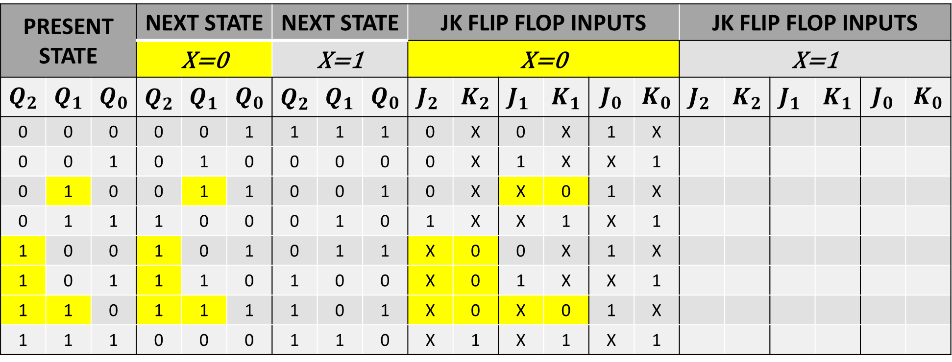
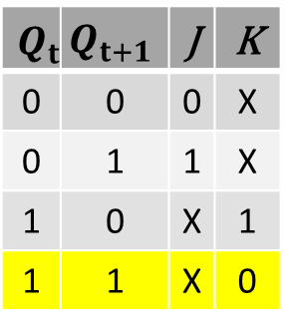
NEXT STATE TABLE USING JK FLIP FLOP for X=0
$$Q_{t}$$ | $$Q_{t+1}$$ | J | K
0 | 0 | 0 | X
0 | 1 | 1 | X
1 | 0 | X | 1
1 | 1 | X | 0
PRESENT STATE |  |  | NEXT STATE |  |  | NEXT STATE |  |  | JK FLIP FLOP INPUTS |  |  |  |  |  | JK FLIP FLOP INPUTS
 |  |  | X=0 |  |  | X=1 |  |  | X=0 |  |  |  |  |  | X=1
$$Q_{2}$$ | $$Q_{1}$$ | $$Q_{0}$$ | $$Q_{2}$$ | $${Q_{1}}_{ }$$ | $$Q_{0}$$ | $$Q_{2}$$ | $${Q_{1}}_{ }$$ | $$Q_{0}$$ | $${J_{2}}_{ }$$ | $${K_{2}}_{ }$$ | $${J_{1}}_{ }$$ | $${K_{1}}_{ }$$ | $$J_{0}$$ | $$K_{0}$$ | $${J_{2}}_{ }$$ | $${K_{2}}_{ }$$ | $${J_{1}}_{ }$$ | $${K_{1}}_{ }$$ | $$J_{0}$$ | $$K_{0}$$
0 | 0 | 0 | 0 | 0 | 1 | 1 | 1 | 1 | 0 | X | 0 | X | 1 | X
0 | 0 | 1 | 0 | 1 | 0 | 0 | 0 | 0 | 0 | X | 1 | X | X | 1
0 | 1 | 0 | 0 | 1 | 1 | 0 | 0 | 1 | 0 | X | X | 0 | 1 | X
0 | 1 | 1 | 1 | 0 | 0 | 0 | 1 | 0 | 1 | X | X | 1 | X | 1
1 | 0 | 0 | 1 | 0 | 1 | 0 | 1 | 1 | X | 0 | 0 | X | 1 | X
1 | 0 | 1 | 1 | 1 | 0 | 1 | 0 | 0 | X | 0 | 1 | X | X | 1
1 | 1 | 0 | 1 | 1 | 1 | 1 | 0 | 1 | X | 0 | X | 0 | 1 | X
1 | 1 | 1 | 0 | 0 | 0 | 1 | 1 | 0 | X | 1 | X | 1 | X | 1

Slide 10
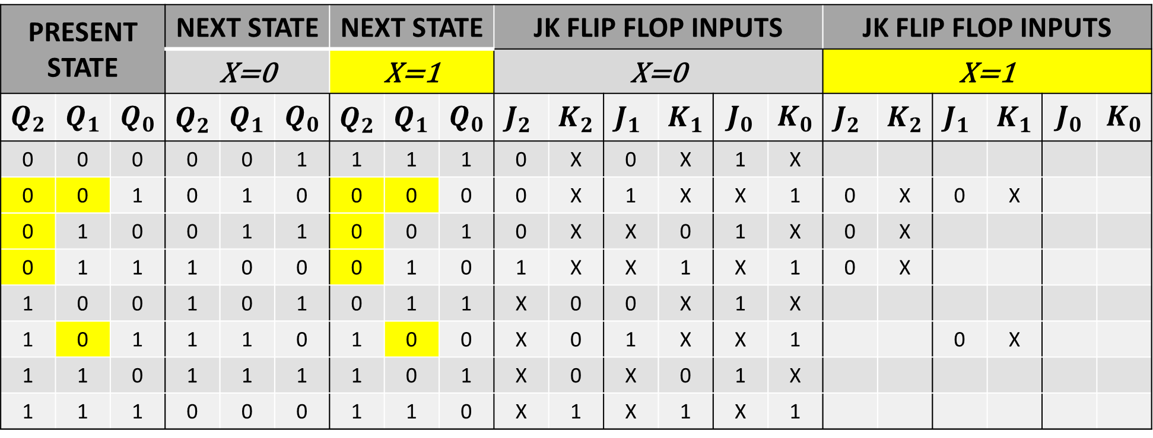

NEXT STATE TABLE USING JK FLIP FLOP for X=1
$$Q_{t}$$ | $$Q_{t+1}$$ | J | K
0 | 0 | 0 | X
0 | 1 | 1 | X
1 | 0 | X | 1
1 | 1 | X | 0
PRESENT STATE |  |  | NEXT STATE |  |  | NEXT STATE |  |  | JK FLIP FLOP INPUTS |  |  |  |  |  | JK FLIP FLOP INPUTS
 |  |  | X=0 |  |  | X=1 |  |  | X=0 |  |  |  |  |  | X=1
$$Q_{2}$$ | $$Q_{1}$$ | $$Q_{0}$$ | $$Q_{2}$$ | $${Q_{1}}_{ }$$ | $$Q_{0}$$ | $$Q_{2}$$ | $${Q_{1}}_{ }$$ | $$Q_{0}$$ | $${J_{2}}_{ }$$ | $${K_{2}}_{ }$$ | $${J_{1}}_{ }$$ | $${K_{1}}_{ }$$ | $$J_{0}$$ | $$K_{0}$$ | $${J_{2}}_{ }$$ | $${K_{2}}_{ }$$ | $${J_{1}}_{ }$$ | $${K_{1}}_{ }$$ | $$J_{0}$$ | $$K_{0}$$
0 | 0 | 0 | 0 | 0 | 1 | 1 | 1 | 1 | 0 | X | 0 | X | 1 | X
0 | 0 | 1 | 0 | 1 | 0 | 0 | 0 | 0 | 0 | X | 1 | X | X | 1 | 0 | X | 0 | X
0 | 1 | 0 | 0 | 1 | 1 | 0 | 0 | 1 | 0 | X | X | 0 | 1 | X | 0 | X
0 | 1 | 1 | 1 | 0 | 0 | 0 | 1 | 0 | 1 | X | X | 1 | X | 1 | 0 | X
1 | 0 | 0 | 1 | 0 | 1 | 0 | 1 | 1 | X | 0 | 0 | X | 1 | X
1 | 0 | 1 | 1 | 1 | 0 | 1 | 0 | 0 | X | 0 | 1 | X | X | 1 |  |  | 0 | X
1 | 1 | 0 | 1 | 1 | 1 | 1 | 0 | 1 | X | 0 | X | 0 | 1 | X
1 | 1 | 1 | 0 | 0 | 0 | 1 | 1 | 0 | X | 1 | X | 1 | X | 1

Slide 11
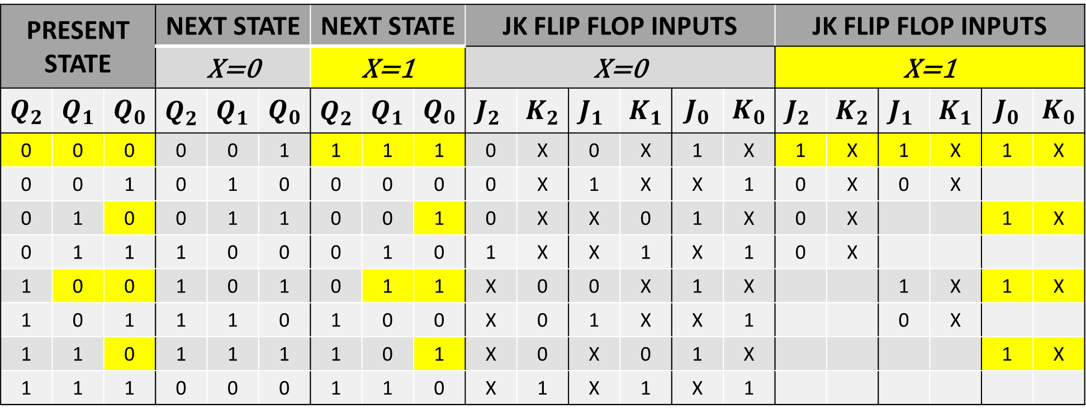
NEXT STATE TABLE USING JK FLIP FLOP for X=1
$$Q_{t}$$ | $$Q_{t+1}$$ | J | K
0 | 0 | 0 | X
0 | 1 | 1 | X
1 | 0 | X | 1
1 | 1 | X | 0
PRESENT STATE |  |  | NEXT STATE |  |  | NEXT STATE |  |  | JK FLIP FLOP INPUTS |  |  |  |  |  | JK FLIP FLOP INPUTS
 |  |  | X=0 |  |  | X=1 |  |  | X=0 |  |  |  |  |  | X=1
$$Q_{2}$$ | $$Q_{1}$$ | $$Q_{0}$$ | $$Q_{2}$$ | $${Q_{1}}_{ }$$ | $$Q_{0}$$ | $$Q_{2}$$ | $${Q_{1}}_{ }$$ | $$Q_{0}$$ | $${J_{2}}_{ }$$ | $${K_{2}}_{ }$$ | $${J_{1}}_{ }$$ | $${K_{1}}_{ }$$ | $$J_{0}$$ | $$K_{0}$$ | $${J_{2}}_{ }$$ | $${K_{2}}_{ }$$ | $${J_{1}}_{ }$$ | $${K_{1}}_{ }$$ | $$J_{0}$$ | $$K_{0}$$
0 | 0 | 0 | 0 | 0 | 1 | 1 | 1 | 1 | 0 | X | 0 | X | 1 | X | 1 | X | 1 | X | 1 | X
0 | 0 | 1 | 0 | 1 | 0 | 0 | 0 | 0 | 0 | X | 1 | X | X | 1 | 0 | X | 0 | X
0 | 1 | 0 | 0 | 1 | 1 | 0 | 0 | 1 | 0 | X | X | 0 | 1 | X | 0 | X |  |  | 1 | X
0 | 1 | 1 | 1 | 0 | 0 | 0 | 1 | 0 | 1 | X | X | 1 | X | 1 | 0 | X
1 | 0 | 0 | 1 | 0 | 1 | 0 | 1 | 1 | X | 0 | 0 | X | 1 | X |  |  | 1 | X | 1 | X
1 | 0 | 1 | 1 | 1 | 0 | 1 | 0 | 0 | X | 0 | 1 | X | X | 1 |  |  | 0 | X
1 | 1 | 0 | 1 | 1 | 1 | 1 | 0 | 1 | X | 0 | X | 0 | 1 | X |  |  |  |  | 1 | X
1 | 1 | 1 | 0 | 0 | 0 | 1 | 1 | 0 | X | 1 | X | 1 | X | 1

Slide 12
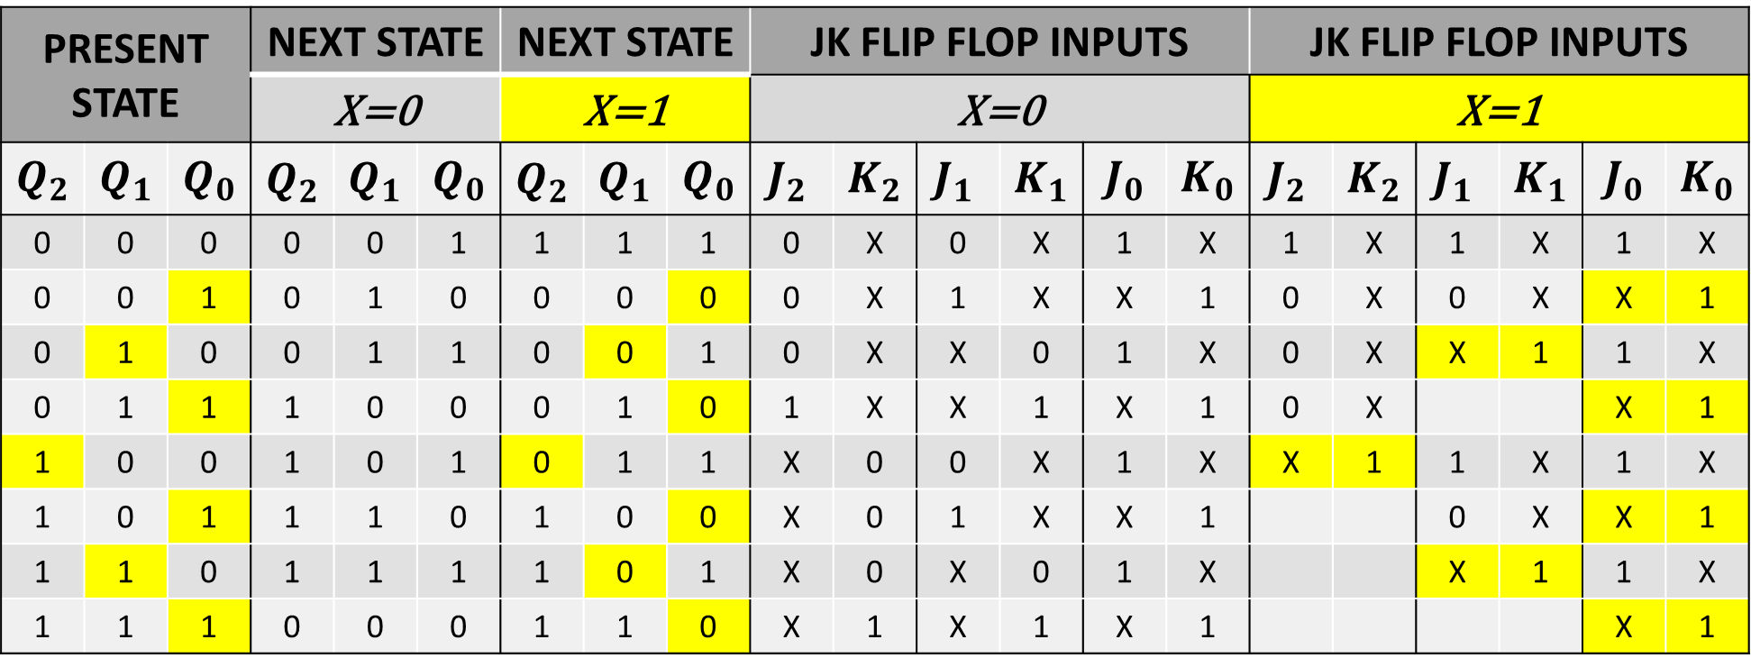
NEXT STATE TABLE USING JK FLIP FLOP for X=1
$$Q_{t}$$ | $$Q_{t+1}$$ | J | K
0 | 0 | 0 | X
0 | 1 | 1 | X
1 | 0 | X | 1
1 | 1 | X | 0
PRESENT STATE |  |  | NEXT STATE |  |  | NEXT STATE |  |  | JK FLIP FLOP INPUTS |  |  |  |  |  | JK FLIP FLOP INPUTS
 |  |  | X=0 |  |  | X=1 |  |  | X=0 |  |  |  |  |  | X=1
$$Q_{2}$$ | $$Q_{1}$$ | $$Q_{0}$$ | $$Q_{2}$$ | $${Q_{1}}_{ }$$ | $$Q_{0}$$ | $$Q_{2}$$ | $${Q_{1}}_{ }$$ | $$Q_{0}$$ | $${J_{2}}_{ }$$ | $${K_{2}}_{ }$$ | $${J_{1}}_{ }$$ | $${K_{1}}_{ }$$ | $$J_{0}$$ | $$K_{0}$$ | $${J_{2}}_{ }$$ | $${K_{2}}_{ }$$ | $${J_{1}}_{ }$$ | $${K_{1}}_{ }$$ | $$J_{0}$$ | $$K_{0}$$
0 | 0 | 0 | 0 | 0 | 1 | 1 | 1 | 1 | 0 | X | 0 | X | 1 | X | 1 | X | 1 | X | 1 | X
0 | 0 | 1 | 0 | 1 | 0 | 0 | 0 | 0 | 0 | X | 1 | X | X | 1 | 0 | X | 0 | X | X | 1
0 | 1 | 0 | 0 | 1 | 1 | 0 | 0 | 1 | 0 | X | X | 0 | 1 | X | 0 | X | X | 1 | 1 | X
0 | 1 | 1 | 1 | 0 | 0 | 0 | 1 | 0 | 1 | X | X | 1 | X | 1 | 0 | X |  |  | X | 1
1 | 0 | 0 | 1 | 0 | 1 | 0 | 1 | 1 | X | 0 | 0 | X | 1 | X | X | 1 | 1 | X | 1 | X
1 | 0 | 1 | 1 | 1 | 0 | 1 | 0 | 0 | X | 0 | 1 | X | X | 1 |  |  | 0 | X | X | 1
1 | 1 | 0 | 1 | 1 | 1 | 1 | 0 | 1 | X | 0 | X | 0 | 1 | X |  |  | X | 1 | 1 | X
1 | 1 | 1 | 0 | 0 | 0 | 1 | 1 | 0 | X | 1 | X | 1 | X | 1 |  |  |  |  | X | 1

Slide 13
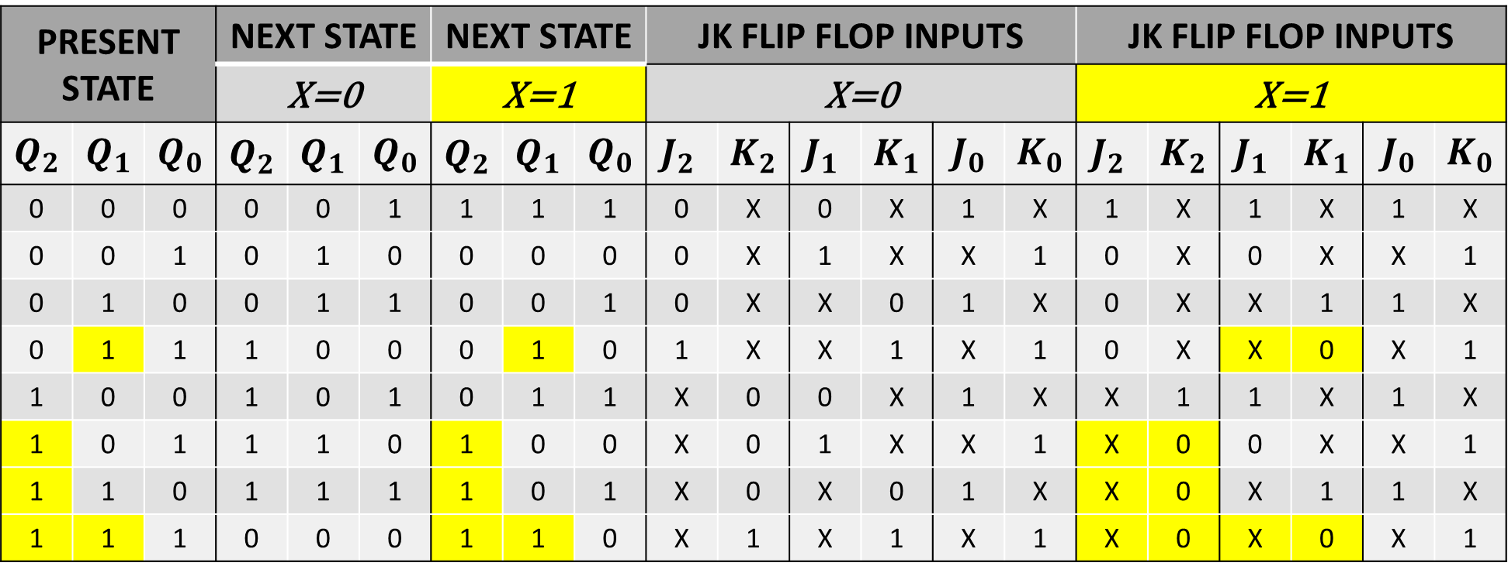
NEXT STATE TABLE USING JK FLIP FLOP for X=1
$$Q_{t}$$ | $$Q_{t+1}$$ | J | K
0 | 0 | 0 | X
0 | 1 | 1 | X
1 | 0 | X | 1
1 | 1 | X | 0
PRESENT STATE |  |  | NEXT STATE |  |  | NEXT STATE |  |  | JK FLIP FLOP INPUTS |  |  |  |  |  | JK FLIP FLOP INPUTS
 |  |  | X=0 |  |  | X=1 |  |  | X=0 |  |  |  |  |  | X=1
$$Q_{2}$$ | $$Q_{1}$$ | $$Q_{0}$$ | $$Q_{2}$$ | $${Q_{1}}_{ }$$ | $$Q_{0}$$ | $$Q_{2}$$ | $${Q_{1}}_{ }$$ | $$Q_{0}$$ | $${J_{2}}_{ }$$ | $${K_{2}}_{ }$$ | $${J_{1}}_{ }$$ | $${K_{1}}_{ }$$ | $$J_{0}$$ | $$K_{0}$$ | $${J_{2}}_{ }$$ | $${K_{2}}_{ }$$ | $${J_{1}}_{ }$$ | $${K_{1}}_{ }$$ | $$J_{0}$$ | $$K_{0}$$
0 | 0 | 0 | 0 | 0 | 1 | 1 | 1 | 1 | 0 | X | 0 | X | 1 | X | 1 | X | 1 | X | 1 | X
0 | 0 | 1 | 0 | 1 | 0 | 0 | 0 | 0 | 0 | X | 1 | X | X | 1 | 0 | X | 0 | X | X | 1
0 | 1 | 0 | 0 | 1 | 1 | 0 | 0 | 1 | 0 | X | X | 0 | 1 | X | 0 | X | X | 1 | 1 | X
0 | 1 | 1 | 1 | 0 | 0 | 0 | 1 | 0 | 1 | X | X | 1 | X | 1 | 0 | X | X | 0 | X | 1
1 | 0 | 0 | 1 | 0 | 1 | 0 | 1 | 1 | X | 0 | 0 | X | 1 | X | X | 1 | 1 | X | 1 | X
1 | 0 | 1 | 1 | 1 | 0 | 1 | 0 | 0 | X | 0 | 1 | X | X | 1 | X | 0 | 0 | X | X | 1
1 | 1 | 0 | 1 | 1 | 1 | 1 | 0 | 1 | X | 0 | X | 0 | 1 | X | X | 0 | X | 1 | 1 | X
1 | 1 | 1 | 0 | 0 | 0 | 1 | 1 | 0 | X | 1 | X | 1 | X | 1 | X | 0 | X | 0 | X | 1

Slide 14
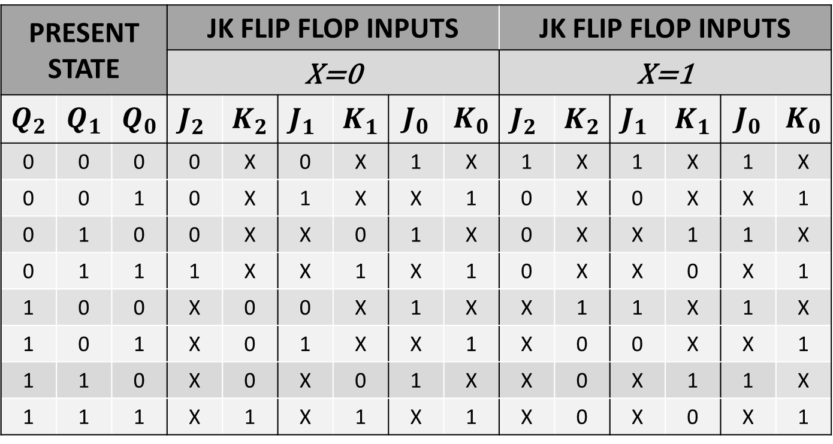
NEXT STATE TABLE USING JK FLIP FLOP
PRESENT STATE |  |  | JK FLIP FLOP INPUTS |  |  |  |  |  | JK FLIP FLOP INPUTS
 |  |  | X=0 |  |  |  |  |  | X=1
$$Q_{2}$$ | $$Q_{1}$$ | $$Q_{0}$$ | $${J_{2}}_{ }$$ | $${K_{2}}_{ }$$ | $${J_{1}}_{ }$$ | $${K_{1}}_{ }$$ | $$J_{0}$$ | $$K_{0}$$ | $${J_{2}}_{ }$$ | $${K_{2}}_{ }$$ | $${J_{1}}_{ }$$ | $${K_{1}}_{ }$$ | $$J_{0}$$ | $$K_{0}$$
0 | 0 | 0 | 0 | X | 0 | X | 1 | X | 1 | X | 1 | X | 1 | X
0 | 0 | 1 | 0 | X | 1 | X | X | 1 | 0 | X | 0 | X | X | 1
0 | 1 | 0 | 0 | X | X | 0 | 1 | X | 0 | X | X | 1 | 1 | X
0 | 1 | 1 | 1 | X | X | 1 | X | 1 | 0 | X | X | 0 | X | 1
1 | 0 | 0 | X | 0 | 0 | X | 1 | X | X | 1 | 1 | X | 1 | X
1 | 0 | 1 | X | 0 | 1 | X | X | 1 | X | 0 | 0 | X | X | 1
1 | 1 | 0 | X | 0 | X | 0 | 1 | X | X | 0 | X | 1 | 1 | X
1 | 1 | 1 | X | 1 | X | 1 | X | 1 | X | 0 | X | 0 | X | 1

Slide 15
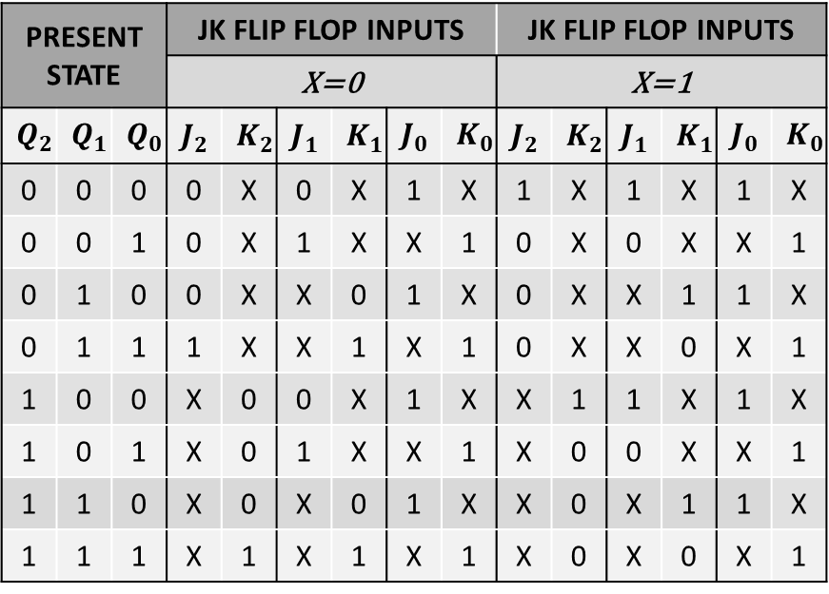
NEXT STATE TABLE USING JK FLIP FLOP
PRESENT STATE |  |  | JK FLIP FLOP INPUTS |  |  |  |  |  | JK FLIP FLOP INPUTS
 |  |  | X=0 |  |  |  |  |  | X=1
$$Q_{2}$$ | $$Q_{1}$$ | $$Q_{0}$$ | $${J_{2}}_{ }$$ | $${K_{2}}_{ }$$ | $${J_{1}}_{ }$$ | $${K_{1}}_{ }$$ | $$J_{0}$$ | $$K_{0}$$ | $${J_{2}}_{ }$$ | $${K_{2}}_{ }$$ | $${J_{1}}_{ }$$ | $${K_{1}}_{ }$$ | $$J_{0}$$ | $$K_{0}$$
0 | 0 | 0 | 0 | X | 0 | X | 1 | X | 1 | X | 1 | X | 1 | X
0 | 0 | 1 | 0 | X | 1 | X | X | 1 | 0 | X | 0 | X | X | 1
0 | 1 | 0 | 0 | X | X | 0 | 1 | X | 0 | X | X | 1 | 1 | X
0 | 1 | 1 | 1 | X | X | 1 | X | 1 | 0 | X | X | 0 | X | 1
1 | 0 | 0 | X | 0 | 0 | X | 1 | X | X | 1 | 1 | X | 1 | X
1 | 0 | 1 | X | 0 | 1 | X | X | 1 | X | 0 | 0 | X | X | 1
1 | 1 | 0 | X | 0 | X | 0 | 1 | X | X | 0 | X | 1 | 1 | X
1 | 1 | 1 | X | 1 | X | 1 | X | 1 | X | 0 | X | 0 | X | 1

Slide 16

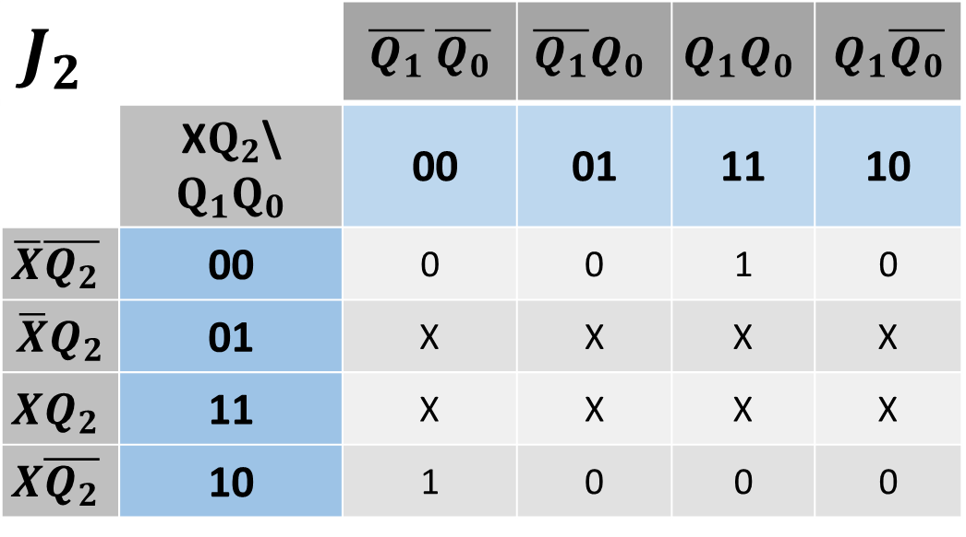
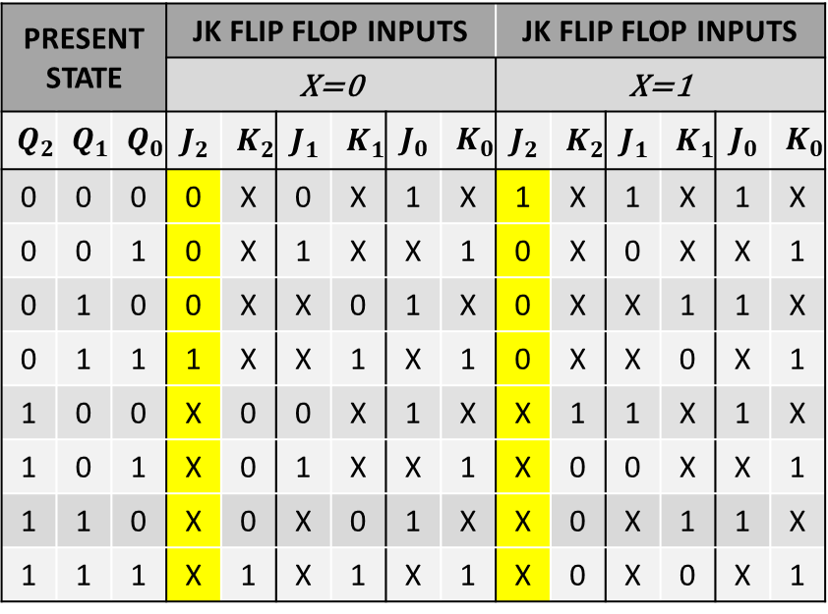
SIMPLIFICATION(K-MAP)
PRESENT STATE |  |  | JK FLIP FLOP INPUTS |  |  |  |  |  | JK FLIP FLOP INPUTS
 |  |  | X=0 |  |  |  |  |  | X=1
$$Q_{2}$$ | $$Q_{1}$$ | $$Q_{0}$$ | $${J_{2}}_{ }$$ | $${K_{2}}_{ }$$ | $${J_{1}}_{ }$$ | $${K_{1}}_{ }$$ | $$J_{0}$$ | $$K_{0}$$ | $${J_{2}}_{ }$$ | $${K_{2}}_{ }$$ | $${J_{1}}_{ }$$ | $${K_{1}}_{ }$$ | $$J_{0}$$ | $$K_{0}$$
0 | 0 | 0 | 0 | X | 0 | X | 1 | X | 1 | X | 1 | X | 1 | X
0 | 0 | 1 | 0 | X | 1 | X | X | 1 | 0 | X | 0 | X | X | 1
0 | 1 | 0 | 0 | X | X | 0 | 1 | X | 0 | X | X | 1 | 1 | X
0 | 1 | 1 | 1 | X | X | 1 | X | 1 | 0 | X | X | 0 | X | 1
1 | 0 | 0 | X | 0 | 0 | X | 1 | X | X | 1 | 1 | X | 1 | X
1 | 0 | 1 | X | 0 | 1 | X | X | 1 | X | 0 | 0 | X | X | 1
1 | 1 | 0 | X | 0 | X | 0 | 1 | X | X | 0 | X | 1 | 1 | X
1 | 1 | 1 | X | 1 | X | 1 | X | 1 | X | 0 | X | 0 | X | 1
$$J_{2}$$ |  | $\overline{Q_{1}}$ $\overline{Q_{0}}$ | $$\overline{Q_{1}}Q_{0}$$ | $$Q_{1}Q_{0}$$ | $Q_{1}\overline{Q_{0}}$
 | X$Q_{2}$\$Q_{1}Q_{0}$ | 00 | 01 | 11 | 10
$$\overline{X}\overline{Q_{2}}$$ | 00 | 0 | 0 | 1 | 0
$$\overline{X}Q_{2}$$ | 01 | X | X | X | X
$$XQ_{2}$$ | 11 | X | X | X | X
$$X\overline{Q_{2}}$$ | 10 | 1 | 0 | 0 | 0
$$J_{2}=X\overline{Q_{1}} \overline{Q_{0}}$$

Slide 17
SIMPLIFICATION(K-MAP)
PRESENT STATE |  |  | JK FLIP FLOP INPUTS |  |  |  |  |  | JK FLIP FLOP INPUTS
 |  |  | X=0 |  |  |  |  |  | X=1
$$Q_{2}$$ | $$Q_{1}$$ | $$Q_{0}$$ | $${J_{2}}_{ }$$ | $${K_{2}}_{ }$$ | $${J_{1}}_{ }$$ | $${K_{1}}_{ }$$ | $$J_{0}$$ | $$K_{0}$$ | $${J_{2}}_{ }$$ | $${K_{2}}_{ }$$ | $${J_{1}}_{ }$$ | $${K_{1}}_{ }$$ | $$J_{0}$$ | $$K_{0}$$
0 | 0 | 0 | 0 | X | 0 | X | 1 | X | 1 | X | 1 | X | 1 | X
0 | 0 | 1 | 0 | X | 1 | X | X | 1 | 0 | X | 0 | X | X | 1
0 | 1 | 0 | 0 | X | X | 0 | 1 | X | 0 | X | X | 1 | 1 | X
0 | 1 | 1 | 1 | X | X | 1 | X | 1 | 0 | X | X | 0 | X | 1
1 | 0 | 0 | X | 0 | 0 | X | 1 | X | X | 1 | 1 | X | 1 | X
1 | 0 | 1 | X | 0 | 1 | X | X | 1 | X | 0 | 0 | X | X | 1
1 | 1 | 0 | X | 0 | X | 0 | 1 | X | X | 0 | X | 1 | 1 | X
1 | 1 | 1 | X | 1 | X | 1 | X | 1 | X | 0 | X | 0 | X | 1
$$J_{2}$$ |  | $\overline{Q_{1}}$ $\overline{Q_{0}}$ | $$\overline{Q_{1}}Q_{0}$$ | $$Q_{1}Q_{0}$$ | $Q_{1}\overline{Q_{0}}$
 | X$Q_{2}$\$Q_{1}Q_{0}$ | 00 | 01 | 11 | 10
$$\overline{X}\overline{Q_{2}}$$ | 00 | 0 | 0 | 1 | 0
$$\overline{X}Q_{2}$$ | 01 | X | X | X | X
$$XQ_{2}$$ | 11 | X | X | X | X
$$X\overline{Q_{2}}$$ | 10 | 1 | 0 | 0 | 0
$$J_{2}=X\overline{Q_{1}} \overline{Q_{0}}+{\overline{X}Q}_{1}Q_{0}$$

Slide 18


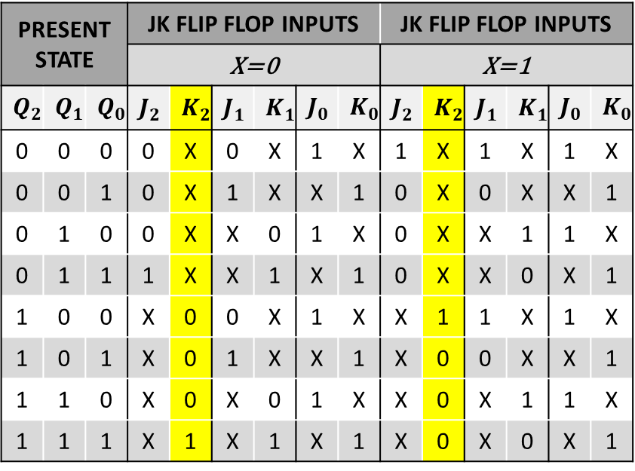
SIMPLIFICATION(K-MAP)
PRESENT STATE |  |  | JK FLIP FLOP INPUTS |  |  |  |  |  | JK FLIP FLOP INPUTS
 |  |  | X=0 |  |  |  |  |  | X=1
$$Q_{2}$$ | $$Q_{1}$$ | $$Q_{0}$$ | $${J_{2}}_{ }$$ | $${K_{2}}_{ }$$ | $${J_{1}}_{ }$$ | $${K_{1}}_{ }$$ | $$J_{0}$$ | $$K_{0}$$ | $${J_{2}}_{ }$$ | $${K_{2}}_{ }$$ | $${J_{1}}_{ }$$ | $${K_{1}}_{ }$$ | $$J_{0}$$ | $$K_{0}$$
0 | 0 | 0 | 0 | X | 0 | X | 1 | X | 1 | X | 1 | X | 1 | X
0 | 0 | 1 | 0 | X | 1 | X | X | 1 | 0 | X | 0 | X | X | 1
0 | 1 | 0 | 0 | X | X | 0 | 1 | X | 0 | X | X | 1 | 1 | X
0 | 1 | 1 | 1 | X | X | 1 | X | 1 | 0 | X | X | 0 | X | 1
1 | 0 | 0 | X | 0 | 0 | X | 1 | X | X | 1 | 1 | X | 1 | X
1 | 0 | 1 | X | 0 | 1 | X | X | 1 | X | 0 | 0 | X | X | 1
1 | 1 | 0 | X | 0 | X | 0 | 1 | X | X | 0 | X | 1 | 1 | X
1 | 1 | 1 | X | 1 | X | 1 | X | 1 | X | 0 | X | 0 | X | 1
$$K_{2}$$ |  | $\overline{Q_{1}}$ $\overline{Q_{0}}$ | $$\overline{Q_{1}}Q_{0}$$ | $$Q_{1}Q_{0}$$ | $Q_{1}\overline{Q_{0}}$
 | X$Q_{2}$\$Q_{1}Q_{0}$ | 00 | 01 | 11 | 10
$$\overline{X}\overline{Q_{2}}$$ | 00 | X | X | X | X
$$\overline{X}Q_{2}$$ | 01 | 0 | 0 | 1 | 0
$$XQ_{2}$$ | 11 | 1 | 0 | 0 | 0
$$X\overline{Q_{2}}$$ | 10 | X | X | X | X
$$K_{2}=X\overline{Q_{1}} \overline{Q_{0} }$$

Slide 19

SIMPLIFICATION(K-MAP)
PRESENT STATE |  |  | JK FLIP FLOP INPUTS |  |  |  |  |  | JK FLIP FLOP INPUTS
 |  |  | X=0 |  |  |  |  |  | X=1
$$Q_{2}$$ | $$Q_{1}$$ | $$Q_{0}$$ | $${J_{2}}_{ }$$ | $${K_{2}}_{ }$$ | $${J_{1}}_{ }$$ | $${K_{1}}_{ }$$ | $$J_{0}$$ | $$K_{0}$$ | $${J_{2}}_{ }$$ | $${K_{2}}_{ }$$ | $${J_{1}}_{ }$$ | $${K_{1}}_{ }$$ | $$J_{0}$$ | $$K_{0}$$
0 | 0 | 0 | 0 | X | 0 | X | 1 | X | 1 | X | 1 | X | 1 | X
0 | 0 | 1 | 0 | X | 1 | X | X | 1 | 0 | X | 0 | X | X | 1
0 | 1 | 0 | 0 | X | X | 0 | 1 | X | 0 | X | X | 1 | 1 | X
0 | 1 | 1 | 1 | X | X | 1 | X | 1 | 0 | X | X | 0 | X | 1
1 | 0 | 0 | X | 0 | 0 | X | 1 | X | X | 1 | 1 | X | 1 | X
1 | 0 | 1 | X | 0 | 1 | X | X | 1 | X | 0 | 0 | X | X | 1
1 | 1 | 0 | X | 0 | X | 0 | 1 | X | X | 0 | X | 1 | 1 | X
1 | 1 | 1 | X | 1 | X | 1 | X | 1 | X | 0 | X | 0 | X | 1
$$K_{2}$$ |  | $\overline{Q_{1}}$ $\overline{Q_{0}}$ | $$\overline{Q_{1}}Q_{0}$$ | $$Q_{1}Q_{0}$$ | $Q_{1}\overline{Q_{0}}$
 | X$Q_{2}$\$Q_{1}Q_{0}$ | 00 | 01 | 11 | 10
$$\overline{X}\overline{Q_{2}}$$ | 00 | X | X | X | X
$$\overline{X}Q_{2}$$ | 01 | 0 | 0 | 1 | 0
$$XQ_{2}$$ | 11 | 1 | 0 | 0 | 0
$$X\overline{Q_{2}}$$ | 10 | X | X | X | X
$$K_{2}=X\overline{Q_{1}} \overline{Q_{0} }+{\overline{X}Q}_{1}Q_{0}$$

Slide 20


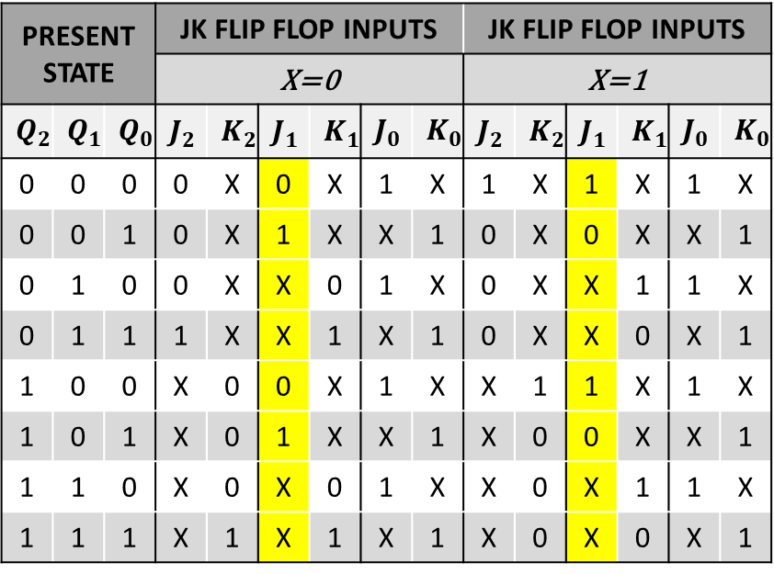
SIMPLIFICATION(K-MAP)
PRESENT STATE |  |  | JK FLIP FLOP INPUTS |  |  |  |  |  | JK FLIP FLOP INPUTS
 |  |  | X=0 |  |  |  |  |  | X=1
$$Q_{2}$$ | $$Q_{1}$$ | $$Q_{0}$$ | $${J_{2}}_{ }$$ | $${K_{2}}_{ }$$ | $${J_{1}}_{ }$$ | $${K_{1}}_{ }$$ | $$J_{0}$$ | $$K_{0}$$ | $${J_{2}}_{ }$$ | $${K_{2}}_{ }$$ | $${J_{1}}_{ }$$ | $${K_{1}}_{ }$$ | $$J_{0}$$ | $$K_{0}$$
0 | 0 | 0 | 0 | X | 0 | X | 1 | X | 1 | X | 1 | X | 1 | X
0 | 0 | 1 | 0 | X | 1 | X | X | 1 | 0 | X | 0 | X | X | 1
0 | 1 | 0 | 0 | X | X | 0 | 1 | X | 0 | X | X | 1 | 1 | X
0 | 1 | 1 | 1 | X | X | 1 | X | 1 | 0 | X | X | 0 | X | 1
1 | 0 | 0 | X | 0 | 0 | X | 1 | X | X | 1 | 1 | X | 1 | X
1 | 0 | 1 | X | 0 | 1 | X | X | 1 | X | 0 | 0 | X | X | 1
1 | 1 | 0 | X | 0 | X | 0 | 1 | X | X | 0 | X | 1 | 1 | X
1 | 1 | 1 | X | 1 | X | 1 | X | 1 | X | 0 | X | 0 | X | 1
$$J_{1}$$ |  | $\overline{Q_{1}}$ $\overline{Q_{0}}$ | $$\overline{Q_{1}}Q_{0}$$ | $$Q_{1}Q_{0}$$ | $Q_{1}\overline{Q_{0}}$
 | X$Q_{2}$\$Q_{1}Q_{0}$ | 00 | 01 | 11 | 10
$$\overline{X}\overline{Q_{2}}$$ | 00 | 0 | 1 | X | X
$$\overline{X}Q_{2}$$ | 01 | 0 | 1 | X | X
$$XQ_{2}$$ | 11 | 1 | 0 | X | X
$$X\overline{Q_{2}}$$ | 10 | 1 | 0 | X | X
$$J_{1}=\overline{X }Q_{0}$$

Slide 21

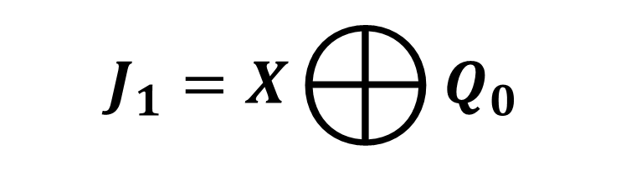
SIMPLIFICATION(K-MAP)
PRESENT STATE |  |  | JK FLIP FLOP INPUTS |  |  |  |  |  | JK FLIP FLOP INPUTS
 |  |  | X=0 |  |  |  |  |  | X=1
$$Q_{2}$$ | $$Q_{1}$$ | $$Q_{0}$$ | $${J_{2}}_{ }$$ | $${K_{2}}_{ }$$ | $${J_{1}}_{ }$$ | $${K_{1}}_{ }$$ | $$J_{0}$$ | $$K_{0}$$ | $${J_{2}}_{ }$$ | $${K_{2}}_{ }$$ | $${J_{1}}_{ }$$ | $${K_{1}}_{ }$$ | $$J_{0}$$ | $$K_{0}$$
0 | 0 | 0 | 0 | X | 0 | X | 1 | X | 1 | X | 1 | X | 1 | X
0 | 0 | 1 | 0 | X | 1 | X | X | 1 | 0 | X | 0 | X | X | 1
0 | 1 | 0 | 0 | X | X | 0 | 1 | X | 0 | X | X | 1 | 1 | X
0 | 1 | 1 | 1 | X | X | 1 | X | 1 | 0 | X | X | 0 | X | 1
1 | 0 | 0 | X | 0 | 0 | X | 1 | X | X | 1 | 1 | X | 1 | X
1 | 0 | 1 | X | 0 | 1 | X | X | 1 | X | 0 | 0 | X | X | 1
1 | 1 | 0 | X | 0 | X | 0 | 1 | X | X | 0 | X | 1 | 1 | X
1 | 1 | 1 | X | 1 | X | 1 | X | 1 | X | 0 | X | 0 | X | 1
$$J_{1}$$ |  | $\overline{Q_{1}}$ $\overline{Q_{0}}$ | $$\overline{Q_{1}}Q_{0}$$ | $$Q_{1}Q_{0}$$ | $Q_{1}\overline{Q_{0}}$
 | X$Q_{2}$\$Q_{1}Q_{0}$ | 00 | 01 | 11 | 10
$$\overline{X}\overline{Q_{2}}$$ | 00 | 0 | 1 | X | X
$$\overline{X}Q_{2}$$ | 01 | 0 | 1 | X | X
$$XQ_{2}$$ | 11 | 1 | 0 | X | X
$$X\overline{Q_{2}}$$ | 10 | 1 | 0 | X | X
$$J_{1}=X⨁{Q_{0}}$$
$$J_{1}=\overline{X}Q_{0}+X\overline{Q_{0} }$$

Slide 22


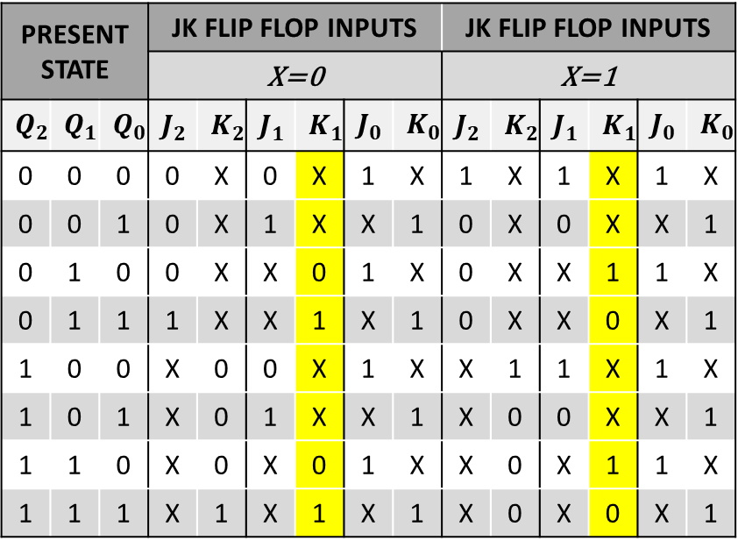
SIMPLIFICATION(K-MAP)
PRESENT STATE |  |  | JK FLIP FLOP INPUTS |  |  |  |  |  | JK FLIP FLOP INPUTS
 |  |  | X=0 |  |  |  |  |  | X=1
$$Q_{2}$$ | $$Q_{1}$$ | $$Q_{0}$$ | $${J_{2}}_{ }$$ | $${K_{2}}_{ }$$ | $${J_{1}}_{ }$$ | $${K_{1}}_{ }$$ | $$J_{0}$$ | $$K_{0}$$ | $${J_{2}}_{ }$$ | $${K_{2}}_{ }$$ | $${J_{1}}_{ }$$ | $${K_{1}}_{ }$$ | $$J_{0}$$ | $$K_{0}$$
0 | 0 | 0 | 0 | X | 0 | X | 1 | X | 1 | X | 1 | X | 1 | X
0 | 0 | 1 | 0 | X | 1 | X | X | 1 | 0 | X | 0 | X | X | 1
0 | 1 | 0 | 0 | X | X | 0 | 1 | X | 0 | X | X | 1 | 1 | X
0 | 1 | 1 | 1 | X | X | 1 | X | 1 | 0 | X | X | 0 | X | 1
1 | 0 | 0 | X | 0 | 0 | X | 1 | X | X | 1 | 1 | X | 1 | X
1 | 0 | 1 | X | 0 | 1 | X | X | 1 | X | 0 | 0 | X | X | 1
1 | 1 | 0 | X | 0 | X | 0 | 1 | X | X | 0 | X | 1 | 1 | X
1 | 1 | 1 | X | 1 | X | 1 | X | 1 | X | 0 | X | 0 | X | 1
$$K_{1}$$ |  | $\overline{Q_{1}}$ $\overline{Q_{0}}$ | $$\overline{Q_{1}}Q_{0}$$ | $$Q_{1}Q_{0}$$ | $Q_{1}\overline{Q_{0}}$
 | X$Q_{2}$\$Q_{1}Q_{0}$ | 00 | 01 | 11 | 10
$$\overline{X}\overline{Q_{2}}$$ | 00 | X | X | 1 | 0
$$\overline{X}Q_{2}$$ | 01 | X | X | 1 | 0
$$XQ_{2}$$ | 11 | X | X | 0 | 1
$$X\overline{Q_{2}}$$ | 10 | X | X | 0 | 1
$$K_{1}=\overline{X}Q_{0}$$

Slide 23
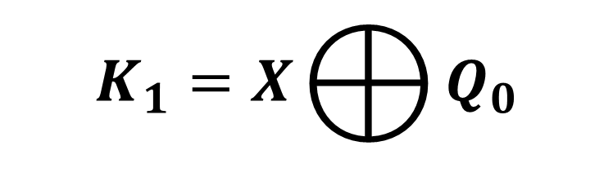

SIMPLIFICATION(K-MAP)
PRESENT STATE |  |  | JK FLIP FLOP INPUTS |  |  |  |  |  | JK FLIP FLOP INPUTS
 |  |  | X=0 |  |  |  |  |  | X=1
$$Q_{2}$$ | $$Q_{1}$$ | $$Q_{0}$$ | $${J_{2}}_{ }$$ | $${K_{2}}_{ }$$ | $${J_{1}}_{ }$$ | $${K_{1}}_{ }$$ | $$J_{0}$$ | $$K_{0}$$ | $${J_{2}}_{ }$$ | $${K_{2}}_{ }$$ | $${J_{1}}_{ }$$ | $${K_{1}}_{ }$$ | $$J_{0}$$ | $$K_{0}$$
0 | 0 | 0 | 0 | X | 0 | X | 1 | X | 1 | X | 1 | X | 1 | X
0 | 0 | 1 | 0 | X | 1 | X | X | 1 | 0 | X | 0 | X | X | 1
0 | 1 | 0 | 0 | X | X | 0 | 1 | X | 0 | X | X | 1 | 1 | X
0 | 1 | 1 | 1 | X | X | 1 | X | 1 | 0 | X | X | 0 | X | 1
1 | 0 | 0 | X | 0 | 0 | X | 1 | X | X | 1 | 1 | X | 1 | X
1 | 0 | 1 | X | 0 | 1 | X | X | 1 | X | 0 | 0 | X | X | 1
1 | 1 | 0 | X | 0 | X | 0 | 1 | X | X | 0 | X | 1 | 1 | X
1 | 1 | 1 | X | 1 | X | 1 | X | 1 | X | 0 | X | 0 | X | 1
$$K_{1}$$ |  | $\overline{Q_{1}}$ $\overline{Q_{0}}$ | $$\overline{Q_{1}}Q_{0}$$ | $$Q_{1}Q_{0}$$ | $Q_{1}\overline{Q_{0}}$
 | X$Q_{2}$\$Q_{1}Q_{0}$ | 00 | 01 | 11 | 10
$$\overline{X}\overline{Q_{2}}$$ | 00 | X | X | 1 | 0
$$\overline{X}Q_{2}$$ | 01 | X | X | 1 | 0
$$XQ_{2}$$ | 11 | X | X | 0 | 1
$$X\overline{Q_{2}}$$ | 10 | X | X | 0 | 1
$$K_{1}=X⨁{Q_{0}}$$
$$K_{1}=\overline{X}Q_{0}+X\overline{Q_{0} }$$

Slide 24


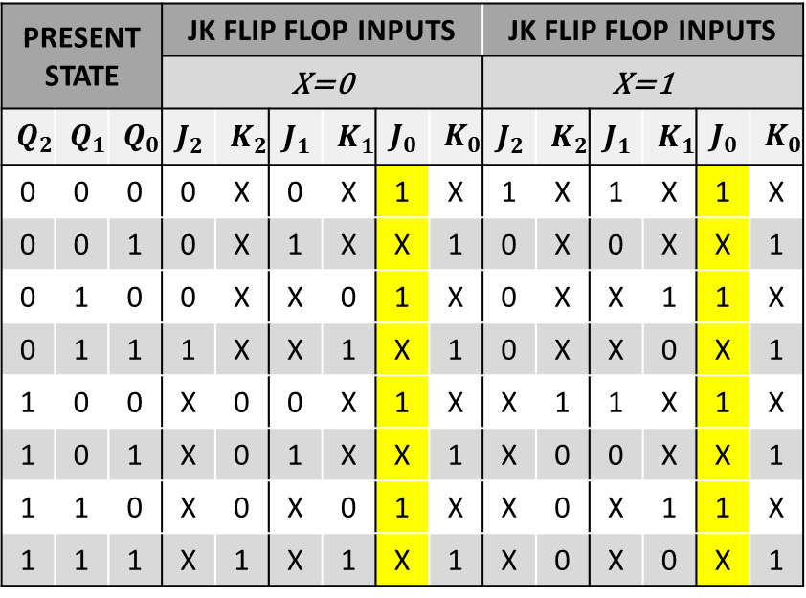
SIMPLIFICATION(K-MAP)
PRESENT STATE |  |  | JK FLIP FLOP INPUTS |  |  |  |  |  | JK FLIP FLOP INPUTS
 |  |  | X=0 |  |  |  |  |  | X=1
$$Q_{2}$$ | $$Q_{1}$$ | $$Q_{0}$$ | $${J_{2}}_{ }$$ | $${K_{2}}_{ }$$ | $${J_{1}}_{ }$$ | $${K_{1}}_{ }$$ | $$J_{0}$$ | $$K_{0}$$ | $${J_{2}}_{ }$$ | $${K_{2}}_{ }$$ | $${J_{1}}_{ }$$ | $${K_{1}}_{ }$$ | $$J_{0}$$ | $$K_{0}$$
0 | 0 | 0 | 0 | X | 0 | X | 1 | X | 1 | X | 1 | X | 1 | X
0 | 0 | 1 | 0 | X | 1 | X | X | 1 | 0 | X | 0 | X | X | 1
0 | 1 | 0 | 0 | X | X | 0 | 1 | X | 0 | X | X | 1 | 1 | X
0 | 1 | 1 | 1 | X | X | 1 | X | 1 | 0 | X | X | 0 | X | 1
1 | 0 | 0 | X | 0 | 0 | X | 1 | X | X | 1 | 1 | X | 1 | X
1 | 0 | 1 | X | 0 | 1 | X | X | 1 | X | 0 | 0 | X | X | 1
1 | 1 | 0 | X | 0 | X | 0 | 1 | X | X | 0 | X | 1 | 1 | X
1 | 1 | 1 | X | 1 | X | 1 | X | 1 | X | 0 | X | 0 | X | 1
$$J_{0}$$ |  | $\overline{Q_{1}}$ $\overline{Q_{0}}$ | $$\overline{Q_{1}}Q_{0}$$ | $$Q_{1}Q_{0}$$ | $Q_{1}\overline{Q_{0}}$
 | X$Q_{2}$\$Q_{1}Q_{0}$ | 00 | 01 | 11 | 10
$$\overline{X}\overline{Q_{2}}$$ | 00 | 1 | X | X | 1
$$\overline{X}Q_{2}$$ | 01 | 1 | X | X | 1
$$XQ_{2}$$ | 11 | 1 | X | X | 1
$$X\overline{Q_{2}}$$ | 10 | 1 | X | X | 1
$$J_{0}=1$$

Slide 25


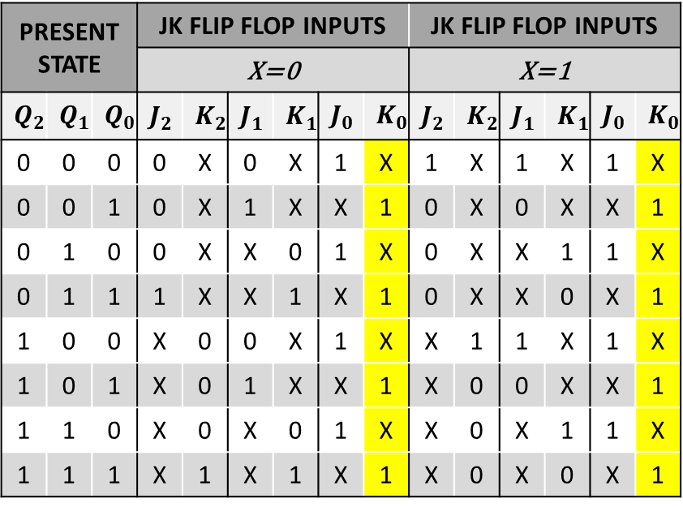
SIMPLIFICATION(K-MAP)
PRESENT STATE |  |  | JK FLIP FLOP INPUTS |  |  |  |  |  | JK FLIP FLOP INPUTS
 |  |  | X=0 |  |  |  |  |  | X=1
$$Q_{2}$$ | $$Q_{1}$$ | $$Q_{0}$$ | $${J_{2}}_{ }$$ | $${K_{2}}_{ }$$ | $${J_{1}}_{ }$$ | $${K_{1}}_{ }$$ | $$J_{0}$$ | $$K_{0}$$ | $${J_{2}}_{ }$$ | $${K_{2}}_{ }$$ | $${J_{1}}_{ }$$ | $${K_{1}}_{ }$$ | $$J_{0}$$ | $$K_{0}$$
0 | 0 | 0 | 0 | X | 0 | X | 1 | X | 1 | X | 1 | X | 1 | X
0 | 0 | 1 | 0 | X | 1 | X | X | 1 | 0 | X | 0 | X | X | 1
0 | 1 | 0 | 0 | X | X | 0 | 1 | X | 0 | X | X | 1 | 1 | X
0 | 1 | 1 | 1 | X | X | 1 | X | 1 | 0 | X | X | 0 | X | 1
1 | 0 | 0 | X | 0 | 0 | X | 1 | X | X | 1 | 1 | X | 1 | X
1 | 0 | 1 | X | 0 | 1 | X | X | 1 | X | 0 | 0 | X | X | 1
1 | 1 | 0 | X | 0 | X | 0 | 1 | X | X | 0 | X | 1 | 1 | X
1 | 1 | 1 | X | 1 | X | 1 | X | 1 | X | 0 | X | 0 | X | 1
$$K_{0}$$ |  | $\overline{Q_{1}}$ $\overline{Q_{0}}$ | $$\overline{Q_{1}}Q_{0}$$ | $$Q_{1}Q_{0}$$ | $Q_{1}\overline{Q_{0}}$
 | X$Q_{2}$\$Q_{1}Q_{0}$ | 00 | 01 | 11 | 10
$$\overline{X}\overline{Q_{2}}$$ | 00 | X | 1 | 1 | X
$$\overline{X}Q_{2}$$ | 01 | X | 1 | 1 | X
$$XQ_{2}$$ | 11 | X | 1 | 1 | X
$$X\overline{Q_{2}}$$ | 10 | X | 1 | 1 | X
$$K_{0}=1$$

Slide 26
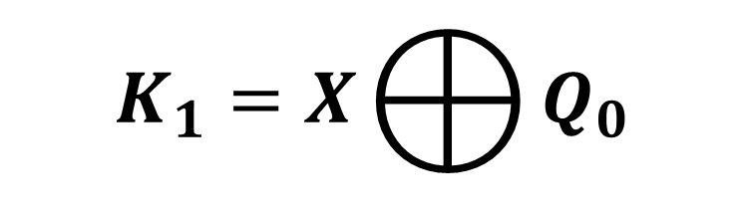
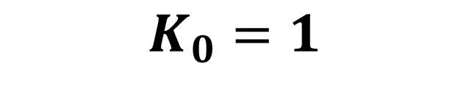
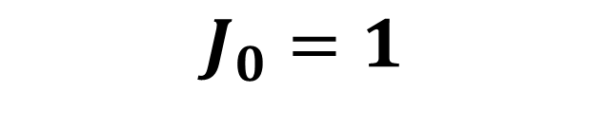
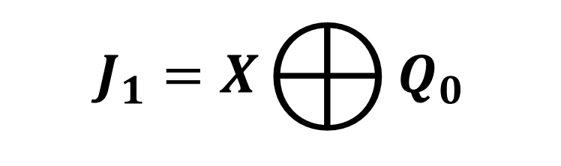
INPUT EQUATIONS
$$J_{2}=X\overline{Q_{1}} \overline{Q_{0}}+{\overline{X}Q}_{1}Q_{0}$$
$$K_{2}=X\overline{Q_{1}} \overline{Q_{0} }+{\overline{X}Q}_{1}Q_{0}$$
$$J_{1}=X⨁{Q_{0}}$$
$$K_{1}=X⨁{Q_{0}}$$
$$J_{0}=1$$
$$K_{0}=1$$

Slide 27
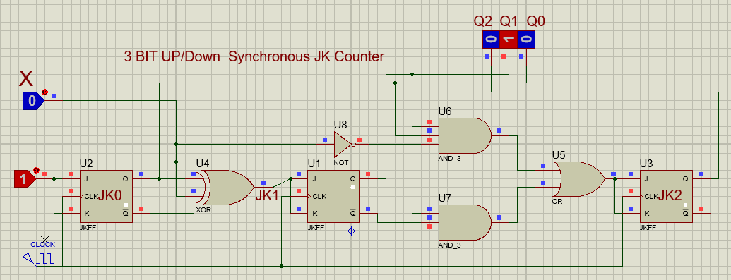
IMPLEMENTATIONS OF EQUATION

